Slide 1
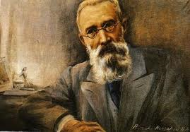
Nikolai Rimsky-Korsakov
Capriccio Espagnole, Op. 34

Slide 2
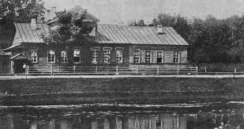
Nikolai Rimsky-Korsakov
Romantic Classical Composer
Born: March 18, 1844
Tikhvin, Russia
Upper Middle Class Family
Notes:
Nikolai Rimsky-Korsakov was a Russian composer who lived during the latter part of the 19th century. He was a composer during the Romantic Classical period. He was born on March 18, 1844 to a family in Tikhvin. His parents were landowners and so he enjoyed opportunities such as being able to live in a nicer family home than those that were available to the Russian peasants of that period of time.

Slide 3
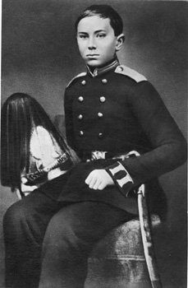
Early Life
Early aptitude for music
Loved books
Enrolled at College of Navel Cadets
Enrolled at age of 12 years
Notes:
Nikolai’s parents both had musical backgrounds and realized early in his life that he also had a gift for music. They realized that he had perfect pitch and excellent time and by the age of six they made sure that he had music lessons (Classical Archives, Retrieved 2013). Rimsky- Korsakov also had a love for books and spent much time studying and he was eventually enrolled at the College of Navel Cadets in St. Petersburg in 1856 (Classical Net, Retrieved 2013). He would have been only 12 years old when he was sent to the College. He decided to pursue a navel career and spent four years at the Navel College, but did continue with his interest in music and piano lessons. During the time he was in the navy, he did not feel he had enough security in his life to pursue a musical career and so he worked in the navy and tried to expand his musical career.

Slide 4
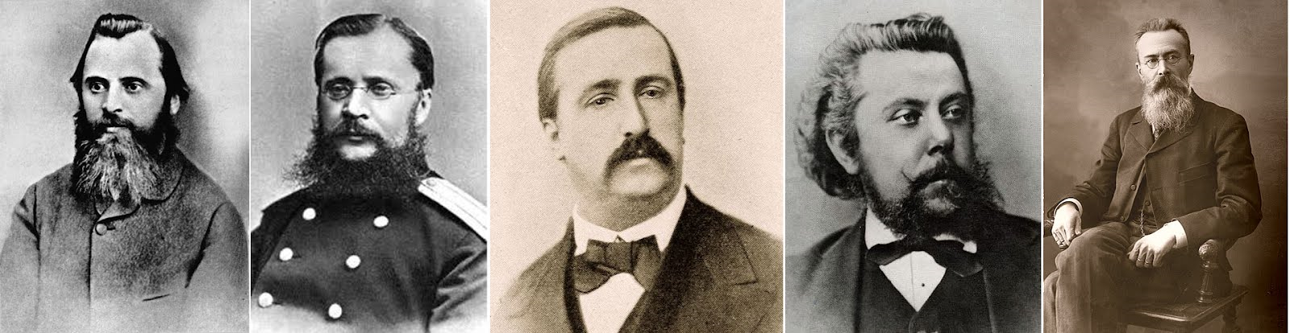
Early Music Career
Association with “The Five”
Professor of Composition and Instrumentation & Leader of the Conservtoire Orchestra
Inspector of Navel Bands
Notes:
In 1859, he became acquainted with Mily Balakirev. Balakirev worked with young musicians such as Borodin, Cui, Mussorgsky, and Stasov who became known as “The Five”. He helped them to understand music methods and pushed them towards the path of successful musicians. Balakirev was the person who actually promoted Rimsky-Korsakov’s ambition to become a composer and impressed on him the idea of completing a symphony. While he was at sea from 1862-1865 he worked on the symphony and was able to premiere it under the direction of Balakirev when he returned to St. Petersburg in 1865 at the age of 21 (Classical Archives, Retrieved 2013). His First Symphony was a success and one of the first important compositions by a Russian composer.
In 1871, he was offered a position as the Professor of Composition and Instrumentation and the leader of the Conservtoire orchestra. He contacted his mentor, Balakirev, about the possibility of accepting this position and finally committed to it. He later commented, “Had I ever studied at all, had I possessed a fraction more knowledge than I actually did, it would have been obvious to me that I could not and should not accept…that it was foolish and dishonest of me to become a professor. But I, the author of Sadko…was a dilettante and knew nothing” (Classical Net, Retrieved 2013). After he took the job, he realized that he really did need to work on changing his style and had concerns about his ability to be creative. When he took this job, it gave him the opportunity to resign his commission with the navy, but he did become the inspector of the naval bands. He held this position until 1884 (Classical Archives, Retrieved 2013).

Slide 5
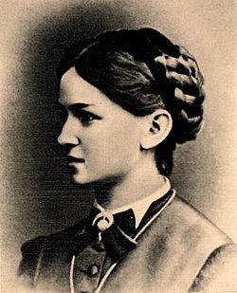
Family
Married Nadezhda Purgold
  Studied composition under Nikolai
  Three children
    Andrey-Becomes Russian Musicologist
Notes:
Rimsky-Korsakov was 27 when he married Nadezhda Purgold. Nadezhda was a pianist in her own right and began playing the piano at the age of nine. She had studied composition under Nikolai, but did more editing and proofreading instead of composition after they were married. One of their children, Andrey, would later become a Russian musicologist (Nadezhda Rimsky-Korsakov, Retrieved 2013).

Slide 6
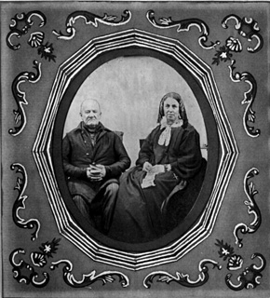
Illness
Retired from world of music
Suffered nervous breakdown
  Death of mother, child, and illness in family
Notes:
1892, Nikolai suffered a nervous breakdown. It was probably brought on by the death of his mother, one of his children, and illness in his family. One of his friends, Tchaikovsky, also died. He took a period of time that he retired from the world of music (Classical Net, Retrieved 2013). In 1895, he was finally able to return to his compositions and completed Christmas Eve which was based on a Gogol story. After that he produced Sadko which was based on a medieval Russian legend (Classical Archives, Retrieved 2013).

Slide 7
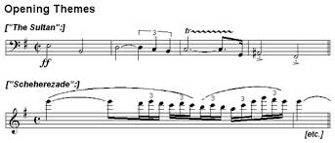
Music
Cappriccio Espangnole
The Tsar’s Bride
Mozart and Salieri
The Tale of Tsar Sultan
Pan Voyevoda, Kastchei,
The Immortal, Vera Sheloga
The Legend of the Invisible City of Kitezh
Golden Cockerel
Notes:
In 1883, Balakirev was appointed as the superintendent of the Court Chapel and Nikolai was his aide. They were both unfamiliar with the type of music Tsar Alexander III wanted them to compose. They worked on choral music for the coronation and other occasions. During this period of time, he worked on Prince Igor and Borodin’s Third Symphony (Classical Net, Retrieved 2013). He eventually took a break from his work on Prince Igor and completed Cappriccio Espangnole which was based on Spanish folk tales (Classical Net, Retrieved 2013). Further works that were based on ethic music include Scheherazade which included stories from the Arabian Nights and the Russian Easter Overture.
The following years were prolific for Nikolai and since so many of his friends had died, he became the leading living Russian composer. The works he produced during this time included The Tsar’s Bride, Mozart and Salieri, The Tale of Tsar Sultan, Pan Voyevoda, Kastchei, The Immortal, Vera Sheloga and The Legend of the Invisible City of Kitezh (Classical Net, Retrieved 2013).

Slide 8
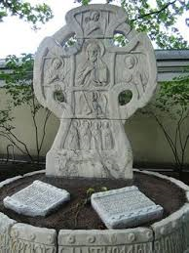
Final Years
Golden Cockerel
  Based on political works of Alexander Pushkin
  Aroused government suspicions
  Produced after his death
Died June 21, 1908
Notes:
. His final opera was the Golden Cockerel which was completed in 1907. This work was based on the political works of Alexander Pushkin. It aroused government suspicions and was not produced until a year after his death in 1909. It was produced by a private opera company in Moscow (Classical Archives, Retrieved 2013).

Slide 9
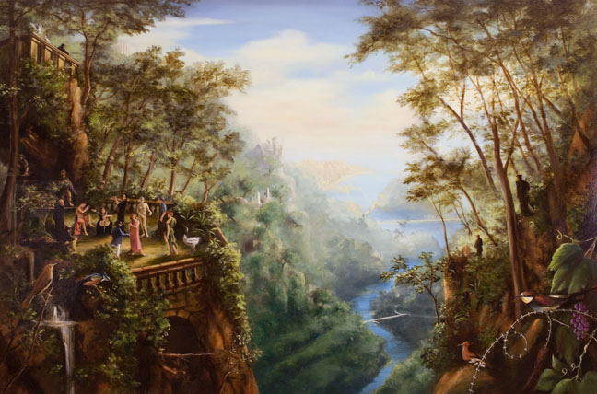
Composition History
& Listening Guide

Slide 10
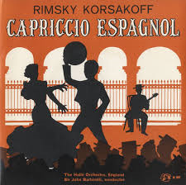
Capriccio Espagnole, Op. 34
Written in 1887
Virtuoso piece for violin and Orchestra
Spanish Themes
Orchestration
Five Movements
Notes:
This piece was written in 1887. Nikolai had enjoyed the Russian folk tales that he had incorporated into his music and decided to use some Spanish melodies for this piece. Originally he wanted the piece to feature the violin with the orchestra as a background. He remarked on this in the following quote from his autobiography, My Musical Life: “and [I] took it into my head to write another virtuoso piece for violin and orchestra, this time on Spanish themes. However, after making a sketch of it I gave up that idea and decided instead to compose an orchestral piece with virtuoso instrumentation. [This piece] was to glitter with dazzling colors . . . “ (The Kennedy Center, Retrieved 2013).
Critics noted that this piece was a brilliant piece for an orchestra. The orchestration gives a wide variety of timbre and allows for many different cadenzas for solo instruments. The piece was originally scored to be played by 2 flutes, a piccolo, 2 oboes (one doubling English horn), 2 clarinets, 2 bassoons, 4 horns, 2 trumpets, 3 trombones, tuba, timpani, percussion, harp and strings (You Tube, Retrieved 2013). Other instruments have been added to later orchestrations of this piece.

Slide 11
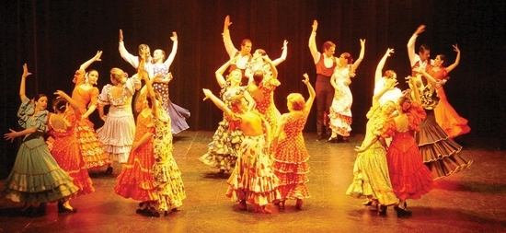
Alborada
Asturian folk music
  Rising of the sun
  Originated in Spain
  Lively dance movement
Notes:
Open link to listen to Capriccio Espagnole: http://www.youtube.com/watch?v=Lh6mDL-VwYw Pause as needed while using listening guide.
The first section, Alborada, is based on Asturian folk music that represents the rising of the sun. This music originated in Spain and the beginning is a lively dance movement (Encyclopedia 4u, Retrieved 2013).
Listening Guide:
Alborada
0:00-The introduction of the song begins with the full orchestra in A major. The dynamics are loud and fast. The timbre of the orchestras is differentiated by the sounds of the brass section, violins and violas, cymbals, and a clarinet solo. The pitch moves from low to high.
0:35-The clarinets and violins take over the movements with oboes and bassoons joining in. It is a light movement that moves to a very fast high pitch.
1:10- The violins and drums take over the movement with a subtle, slower, quiet transition.

Slide 12
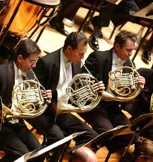
Variations
Introduced by French Horns
Melody moves to different sections
Five variations on melody
Notes:
The second section, Variations, has a theme that is introduced by horns (The Kennedy Center, Retrieved 2013). They carry the melody to begin with and then other sections of the orchestra pick up the melody. There are five different variations in this movement.
Continue YouTube while using listening guide:
Variations
1:31-This section is introduced by the French horns in F major.
2:01- Soft horns begin with a slow movement. The cello enters and the pitch begins to rise.
2:31-the cellos, violins, and other strings continue with a soft dynamics that produces a calm, soothing, slow pace.
3:01-Oboes enter and the pitch rises. The French horns take the melody and then the strings pick it back up with a calm tempo.
3:32-The pace of the movement picks up with French horns dominating the sound. The oboes and French horns take turns giving a soft pitch to the movement and both joining to show the timbre of the movement.
4:11- The French horns again dominate the movement. The violins and other strings come in, the dynamics and timbre of the movement increase with a faster pace.
4:41-The whole orchestra enters. The dynamics are louder, faster, and then the tempo slows down.
5:11-The violins illustrate the plucking of the strings (pizzato). The tempo is a soft, swaying, happy tune.
5:45-The orchestra begins a transition to the next movement which a soft melody.

Slide 13
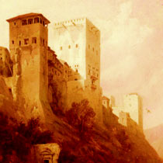
Alborada
Repeat of the Alborada
Key is changed
Violin plays clarinet solo
Violin cadenza played by clarinet
Notes:
The third section is a repeat of the Alborada. However, he changed the key this was written in and changed the instrumentation. The violin takes over the solo for the clarinet and the violin cadenza is played by the clarinet.
Continue YouTube while using listening guide:
Alborada
6:12-The flute introduces a repeat of the first theme only this time it is in B flat major.
6:42-The drums, trumpet, and violins pick up the melody and then the clarinet solo that was at the beginning is picked up by the violin.
7:12-The drums and violins bring in a fast tempo and are joined by the flute and the harp.

Slide 14
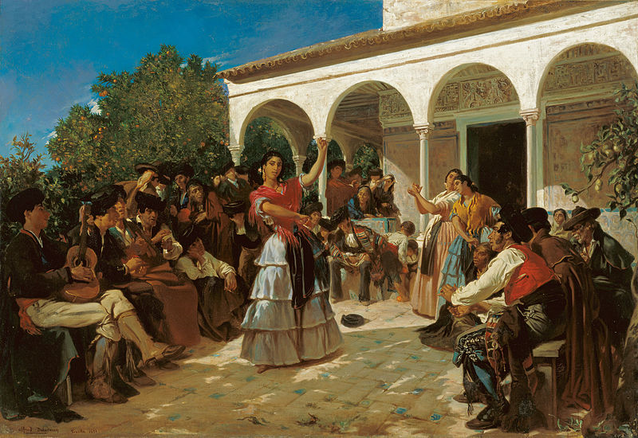
Scena e Canto Gitano
Gypsy scene and song
Brass fanfare and drum roll begins
Various instruments have solos
Notes:
The fourth section of this piece builds in a lively Gypsy scene and song. It begins with a brass fanfare and a drum roll. The violin has various solo parts. The oboe, clarinet, flute, and harp are also featured in various solo cadenzas (Encyclopedia 4u, Retrieved 2013)
Continue YouTube while using listening guide:
Scena e Canto Gitano (Scene and Gypsy Song)
7:40-The drum roll enters with a crescendo followed by the trumpets. The dynamics of the music is louder and you hear the Gypsy melodies begin played by different groups of strings.
8:10-The timbre of the trumpets and the violin solo are heard.
8:43-Small groups of violins, drums, and flutes take turns carrying the melody.
9:13-The flute begins this section with a tune that sounds like the pied piper. They are joined by the clarinet and bassoon.
9:43- The oboes pick up the melody and the harp enters with a glissando. The strings and horns join in.
10:14-The movement shifts to the strings and then the full orchestra joins in.
10:42-The pitch is loud and then the transition is made to the string section of the orchestra with a cello solo and the tempo slows down.
11:13-The cello solo continues and the flute joins in. The violins increase the tempo and the drums are interspersed with the movement getting faster and louder.
11:43-The tempo increases to a fast pace. All of the orchestra enters and pitch builds to a high crescendo.
12:12-The tempo and crescendo builds with the whole orchestra as the movement transitions to the next section.

Slide 15
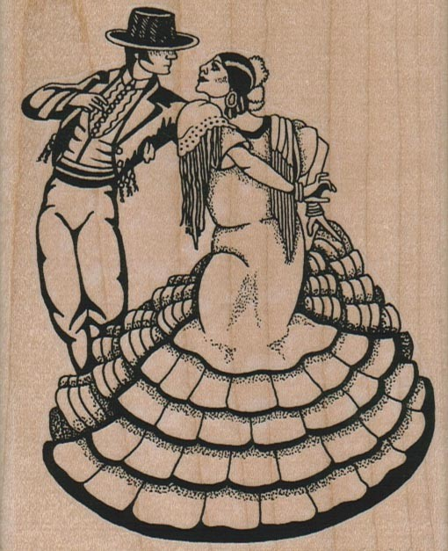
Fandango Asturiano
Final flourish features the Spanish Fandango
Tchaikovsky letter
  Capriccio “colossal masterpiece”
Notes:
The fifth section ends with a dance from the Asturias area of Spain. It ends with a tremendous flourish by all of the instruments in the orchestra. Tchaikovsky sent a letter to Nikolai saying, “that your ‘Spanish Capriccio’ is a colossal masterpiece of instrumentation, and you may regard yourself as the greatest master of the present day.” (The Kennedy Center, Retrieved 2013).
Continue YouTube while using listening guide:
Fandango Asturiano (Fandango of the Asturias)
12:45-Trombones and woodwinds introduce the movement and then it reverts to strings. The strings build the tempo as the pace become faster and louder and the flutes enter.
13:15-The tempo slows by the strings. Castanets have a brief solo and the pitch becomes louder as the oboes enter.
13:45-Clarinets, cymbals, piccolos, and strings build to a crescendo.
14:16-The dynamics increase to a loud pitch. The strings increase to a fast tempo and the flutes join in with a rapidly paced tempo.
14:45-The tempo of the movement builds to a fast pace with all parts of the orchestra joining in. It begins to sound like a race to the finish.
15:18-The French horns and trombones take over the melody and build to the final climax.

Slide 16
Bibliography
(2013, September 16). Retrieved from Nadezhda Rimsky-Korsakov: http://www.tchaikovsky-research.net/en/people/rimskaya-korsakova_nadezhda.html
(Retrieved 2013, September 16). Retrieved from You Tube: http://www.youtube.com/watch?v=55Qx5liqqTQ
Classical Archives. (Retrieved 2013, September 16). Retrieved from Classical Archives-The Ultimate Classical Music Destination: http://www.classicalarchives.com/composer/3231.html
Classical Net. (Retrieved 2013, September 15). Retrieved from The Internet's Premier Classical Music Source: http://www.classical.net/music/comp.lst/rimsky-korsakov.php
Encyclopedia 4u. (Retrieved 2013, September 25). Retrieved from http://www.encyclopedia4u.com/c/capriccio-espagnol.html
The Kennedy Center. (Retrieved 2013, September 24). Retrieved from http://www.kennedy-center.org/calendar/?fuseaction=composition&composition_id=2101

